Slide 1
MY KID WANTS TO JOIN CVMB 2023!!!
….NOW WHAT?!?!

Slide 2
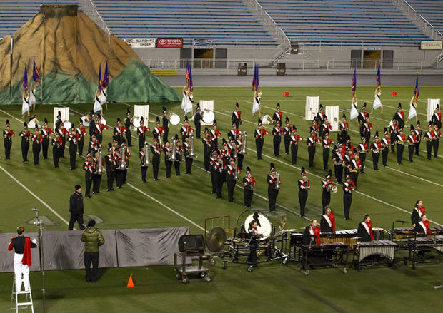
TEAMWORK

Slide 3
BAND CAMP!!!
July 24 – July 28
July 31 – August 4
M-T, 1-9p; Fri, 9a-12:30p (week1), 9a-1:30p (week2).

Slide 4
Rehearsals
Tue/Thu 6p-9p
Fri (Home Games) 3:45p-5p
Saturdays TBD
Summer schedule available!

Slide 5
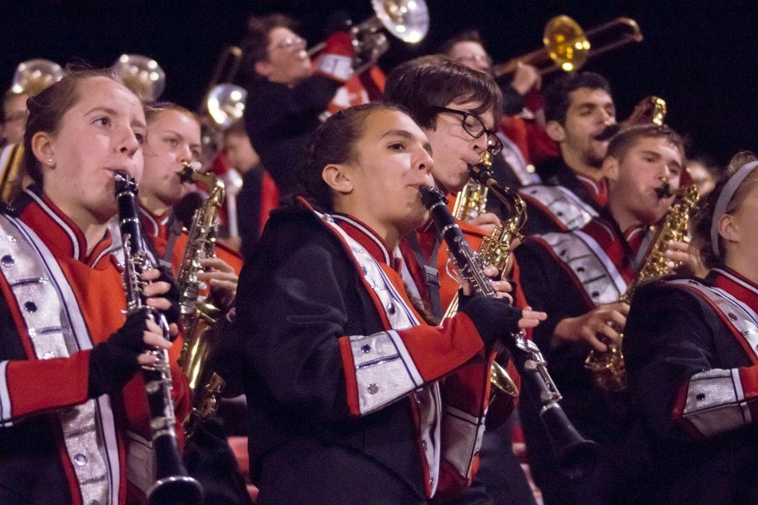
Football Games!
-Regular season is 10 games (mandatory)
-Play-offs as needed (mandatory)
-Play pop/rock tunes during time-outs, between quarters, and either pre-game or half-time

Slide 6
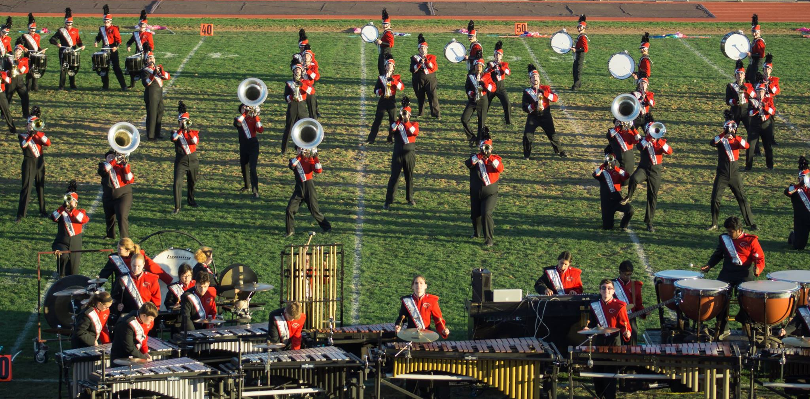
COMPETITIONS!!!
-Held on Saturdays
-3 for 2021 season + Championships
-Rehearse during the day, eat dinner together, get on the bus, show up, show off, go home!

Slide 7
IT’S ACADEMIC!!!
.25 elective credit
Extra time for Seniors?
Pass/Fail
Teaches time management
Looks great on college applications!
Leadership Opportunities

Slide 8
success!!
-2011& 2012 TOB Chapter 6 Champions
-2011 &2012 TOB ACCs, 2nd & 3rd place, respectively
-2013 Cavalcade of Bands Yankee Open Class, 5th
-2014 Cavalcade of Bands Patriot Open Class, 3rd
-2014 Peach Bowl Parade Champions
-2015 Cavalcade of Bands Patriot Open Class, 2nd
-2016 Cavalcade of Bands Patriot Open Class, 5th
-2017 Cavalcade of Bands Patriot Open Class, 5th
-2018 Cavalcade of Bands Patriot A Class, 1st
-2019 Cavalcade of Bands Patriot A Class, 3rd

Slide 9
BIG TRIPS!!! 2022 Disney Orlando 2018 TENNESSEE 2016 Orlando 2014 Atlanta 2012 Orlando 2010 Tampa Bay

Slide 10
FOOOOOOOOD!!!!!
-Dinner provided by Band Boosters before each competition!
-Preferential Line at the Home Side Concessions Stand!
-Halloween “Trick-or-Treat” Party
-Picnic @ Parent Preview & Champs!!!

Slide 11
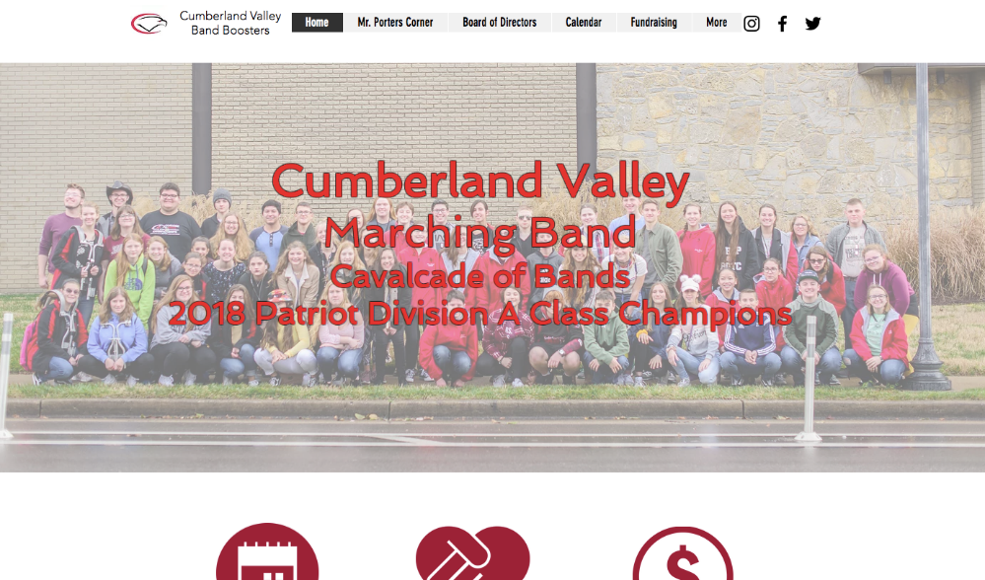
CVBB.ORG
@CumberlandValleyBand
@CVMarchingBand
efarkas@cvschools.org
@CVMarchingBand

